Slide 1
IPL MANAGEMENT SYSTEM
By Autobots
14434 | DEEPALI HANUMANT GOSAVI
14437 | KALPESH MANOHAR PUJARE
14440 | KEERTHI HANSRAJ GERATA
14444 | MANISH UDHAVDAS ROHRA
14442 | MAYURI SURESH BHAGAT
31st July 2019

Slide 2
INTRODUCTION
Our idea is to analyze and maintain the IPL Players and Teams who are going to enroll for the tournament.
There will be 3 roles admin, player, owner.
Admin manages the whole website.
Owners creates team where he can select the players.
Player can register himself for the teams available which are created by owners.
This user friendly website makes system easily manageable and accessible for all the users.
The transparency of our website flashes light on the trust as each and every update is visible to all the users.

Slide 3
INSIGHTS
Front-End | Back-End
Angular 8 : Created component and services | Springboot: Back-End is implemented using spring boot
HTML/CSS: Designing webpages and styling the webpage | Hibernate: ORM framework
Bootstrap: Making webpages responsive | MySQL: For database management
 | MAVEN: Build tool to insert dependencies

Slide 4
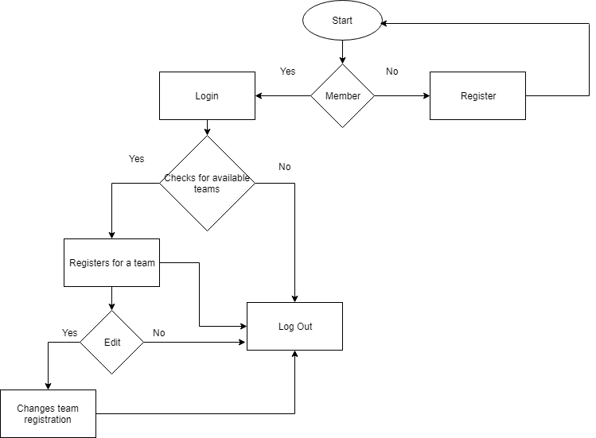
Flow Diagram:- ( Player )

Slide 5
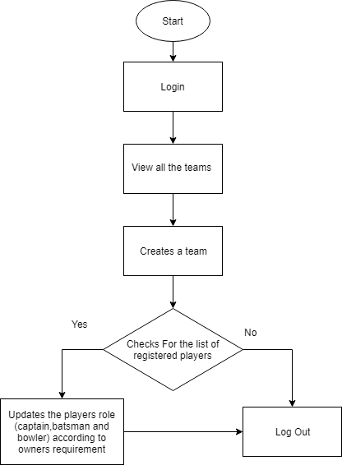
Owner

Slide 6
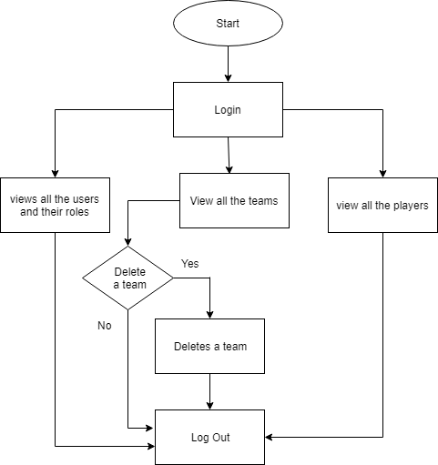
Admin

Slide 7
Business features and Innovation
Implemented various services on 3 roles.
Implemented update operation on player’s role in owner.
When owner register his team, it will dynamically creates link for registered
team at players page.
Used JWT authentication for secured communication.
Performed CRUD operations on Admin, Owner and Player.

Slide 8
Issues Faced and solution
ISSUES FACED | SOLUTION
Role based Authentication | Used JSON web token (JWT) for authentication
2. CRUD operations on various roles. | Used Stack overflow for the solution.
3.Fetching data through different roles from URL in service. | Mentor helped us for the solution.
4.Errors occurred due to CORS policy violation. | Used Stack overflow for the solution.
5.Updating a particular role for the player | Observed carefully for and implemented
6.Routing problem faced from particular role to homepage | Observed carefully the routing and got the solution.

Slide 9
Thank You

